Slide 1


Slide 2

“DIY CBT”
Self-Help Course
Session 1
Introduction

Slide 3
Agenda
Introductions
Group Rules
Measures
What is CBT?
Thoughts, Feelings & Behaviours
STOPP
Relaxation
Feedback

Slide 4
Introductions…
Who we are
Sessions, timing
Session structure
  Agenda, review, homework, relaxation

Slide 5
Measures
Completed prior to or during first session, and during or after last session
HADS
CORE-10

Slide 6

What is CBT?
CBT looks at our thoughts, our feelings and the way we act
SITUATION:
Thoughts
Behaviour
Feelings
Notes:
Give brief examples of depression and anxiety vicious cycles.

Slide 7
Thoughts about, or the meaning we give the event
Event
Emotion
Behaviour

Slide 8
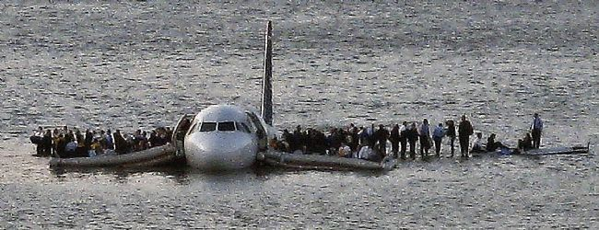
The Plane Crash
155 people on board jet which crashed onto River Hudson in 2009
How did the people feel?
How did they react?
Notes:
In 155 different ways!
Same situation, same outcome, 155 different ways of seeing things.
I

Slide 9
If we could change the way we think
Or change what we do
Then we can change how we feel !

Slide 10
Depression
Notes:
Discuss depression. How it makes us think and feel, what we do or don’t do. Write up all suggestions on the white board.
What causes depression? (circumstances, genetics, neuro-transmitters, upbringing, experiences etc)
How many people are affected? (1 in 4 over the lifespan)
Treatment? NICE guidelines = anti-depressants and psychotherapy (CBT or IPT)

Slide 11
Wake up in the morning
There’s no point
I’ll only mess up again
Thoughts
Stay in bed
Tired
Behaviours
Feelings
Pull covers
over head
Tired

Slide 12
Anxiety
Notes:
Discuss anxiety. Causes. How it makes us think and feel. What we do or don’t do. Write up all suggestions on the whiteboard.
Different kinds of anxiety disorders, but generate the same feelings.

Slide 13
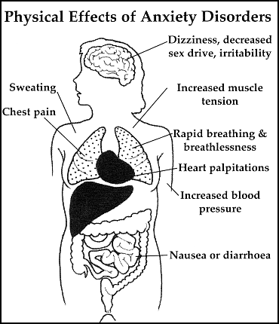

Slide 14
Trigger – real or imagined danger
I can’t cope
Something terrible is going to happen
I feel bad so it must be bad
Thoughts
Physical sensations of anxiety
Avoid, Escape or Freeze
Behaviours
Feelings
Try to cope by doing things that help me feel better or keep me safe.
Anxious, fearful

Slide 15

Anger
Notes:
Discuss anger. How it makes us think, feel and behave.
What does it look like? How do you know when someone is angry?
Causes?
Example: if you were bullied terribly at school, you might become very angry when you feel like you are being bullied now.

Slide 16
Driving car – cut up by another driver
I’ll teach him
That idiot’s deliberately cut me up!
Thoughts
Fired up, tense, heart racing
Shout, stare, make rude gesture
Behaviours
Feelings
Clench wheel, rev loudly, hoot, drive up close
Angry

Slide 17
CBT helps you to help yourself
During the course, you will learn many strategies to help you overcome your problems
You need to commit yourself to the course and work hard!
Like learning to play a musical instrument, you have to practise every day

Slide 18
Homework…
Read the first Step of the self-help course
Complete the Vicious Cycle form:
  Situation
  Thoughts & images
  Feelings
  Behaviours
Notes:
Refer to page 8 of the self-help course

Slide 19
Relax…..
Notes:
Use any of the provided scripts, preferably a different one each week to help the group members to find a method that works for them.
E.g. Progressive Muscle Relaxation, Safe Place Imagery, Mindful Breathing, Colour Breathing

Slide 20
Feedback

